Slide 1
Choosing the optimal location to start a yoga studio in brooklyn

Slide 2
Giving your business the best chance at succeeding
I want to analyse which neighbourhood would be the best to start a yoga studio in Brooklyn NY.
While this is aimed at a yoga studio, most information will be valuable or interchangeable for other business types.
I will look for the best area based on 3 factor. i) Population ii) Average rental price iii) how many competing yoga studios are already in the area

Slide 3
The data
I used the New York Data set to show the various neighbourhoods https://cocl.us/new_york_dataset
I used Foursquare to find the different venues and in particular yoga studios
I scraped rentcafe for their information on the rent prices https://www.rentcafe.com/average-rent-market-trends/us/ny/brooklyn/
I scraped World Atlas for the populations on each of the Brooklyn neighbourhoods https://www.worldatlas.com/articles/brooklyn-neighborhoods-by-population.html

Slide 4
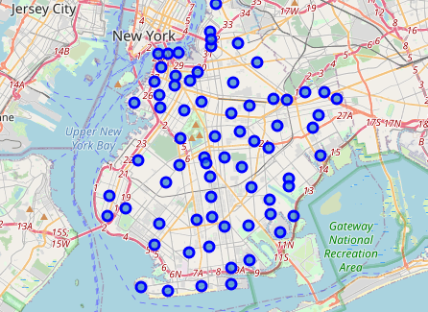
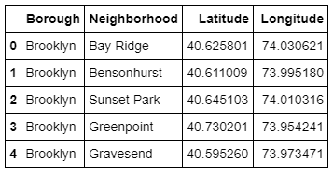
Neighbourhood exact coordinates

Slide 5
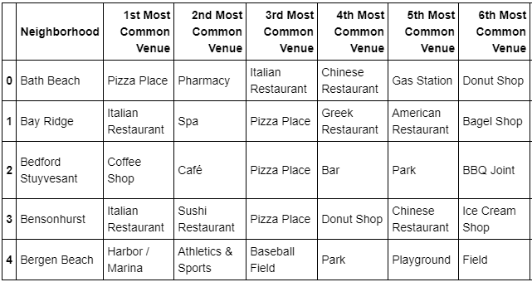
Most common venue by neighbourhood

Slide 6
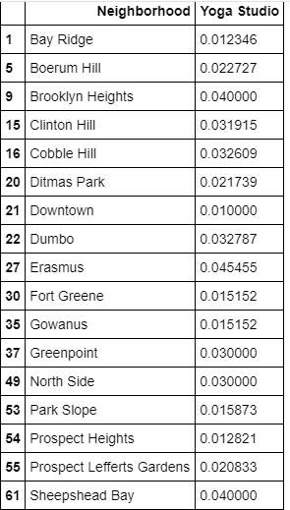
Each of the neighbourhoods with a yoga studio and how common the prevalence of yoga studios were

Slide 7
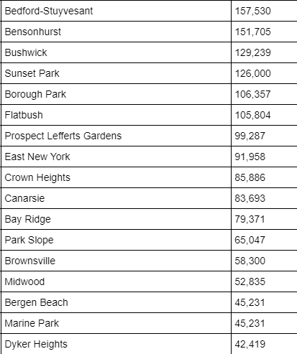
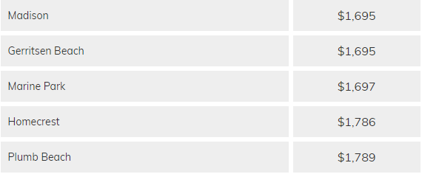
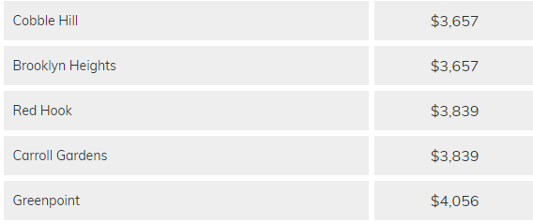
Populations of the neighbourhoods and the average rent of the neighbourhods

Slide 8
Conclusion and Future directions
The decision will come down to the owner and how they want to market their product.
If they want to go for the top end of the market, set their prices high and keep their classes to a small number then they should consider Downtown Brooklyn or Bedford-Stuyvesant.
If the owner wants to have a cheaper model, where the customer pays less and participates in higher volume, lower cost classes, then I would recommend either Bensonhurst or Flatbrush.

